Slide 1
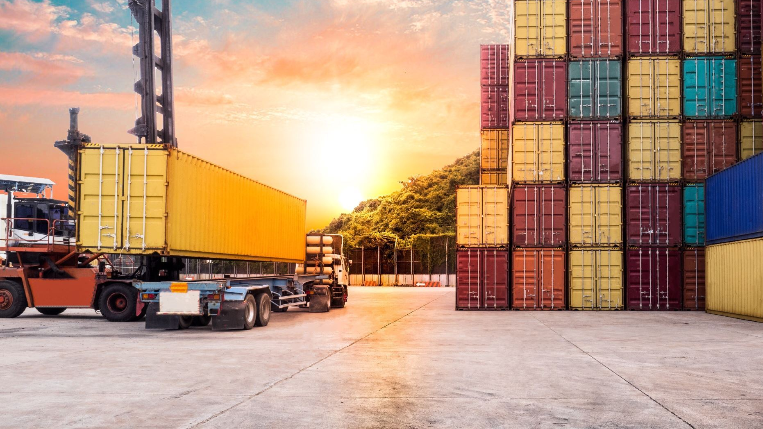
Luyan Logistics Optimization
Haiyue Zhang, Shuo Wang, Yuhong Shao Mentor: Frank Quan, Litong Liu

Slide 2

Introduction
Project Overview
Dataset Overview
Exploratory Data Analysis

Slide 3
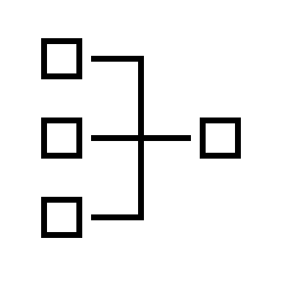
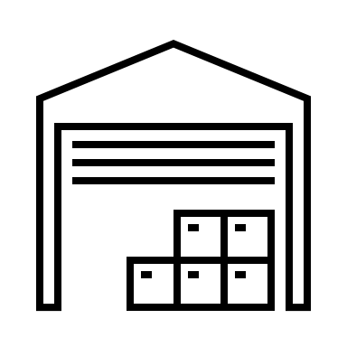
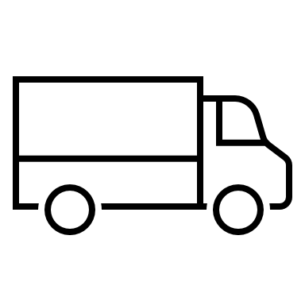
Project Overview
Task:
Muti-vehicle, single-deport, same-city (Xiamen) medicine delivery problem for Luyan Company
General Procedure:
Orders accumulatee
Workers collect items from warehouse
Drivers deliver orders to clients
Previous day
12pm - 8am
8am to the rest of the day
Goal: Develop a route minimizing cost constrained by the vehicle capacity limit and client time window limit.
What orders should one vehicle be responsible for?
In what order should a vehicle travel?
Notes:
根据手头上现有的数据跑的TSP算法

Slide 4
Dataset Overview
Medicine Information
Vehicle Information
ERP Order System
Records the order content and client information
TMS Route Info System
Records the route plans for each order
TMS Transit Info System
Records the travel information of each vehicle
Challenges:
Merging Information from various sours
Correctly identifying missing data and outliers, establish proper data cleaning pipeline
Notes:
根据手头上现有的数据跑的TSP算法

Slide 5
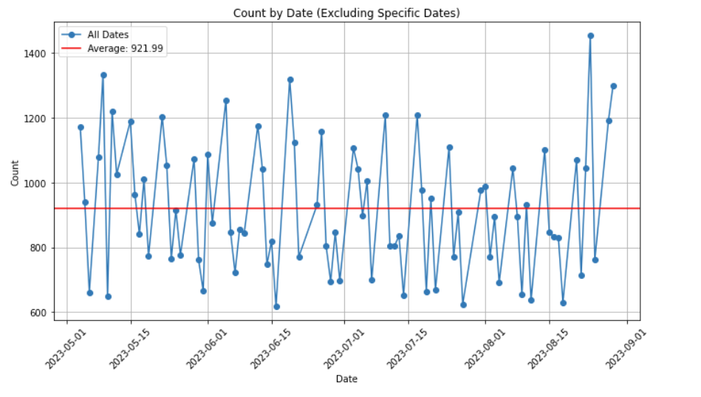
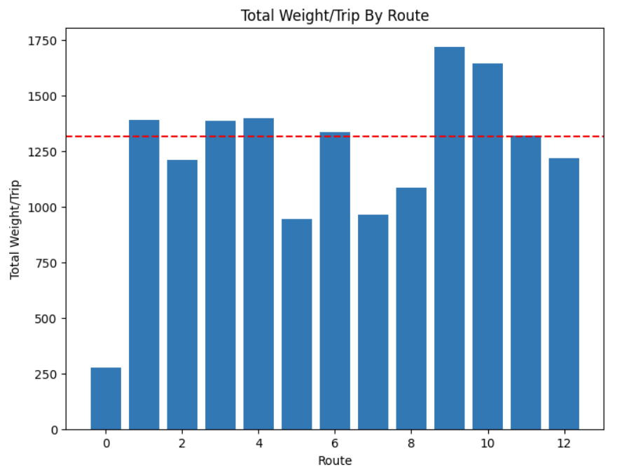
Exploratory Data Analysis
Observation:
Distribution of orders are very diverse across different dates, and we fail to oberserve a common trend in terms of the order number, location or order contents.
There exists imbalanceness within terms of avarge order number, average weight and travel time among routes.
Currently, routes for hundreds of orders are planned completely manually based on experience. Therefore, we believe there is room for potential improvements using optimization models.
Notes:
根据手头上现有的数据跑的TSP算法

Slide 6
Distance/Duration
Straight-line
Navigation API
History vehicle driving record

Slide 7
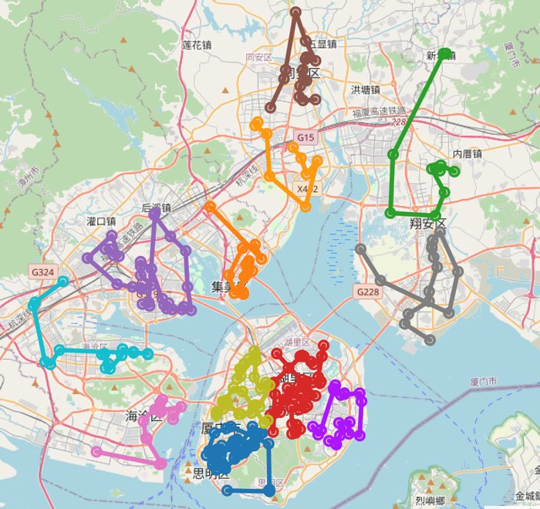
Straight-line
Using Straight Line distance according to the longitude and latitude data of each delivery location
Utilizing Dijkstra/Greedy/Christofides Algorithms to optimize transportation routes for individual trucks

Slide 8
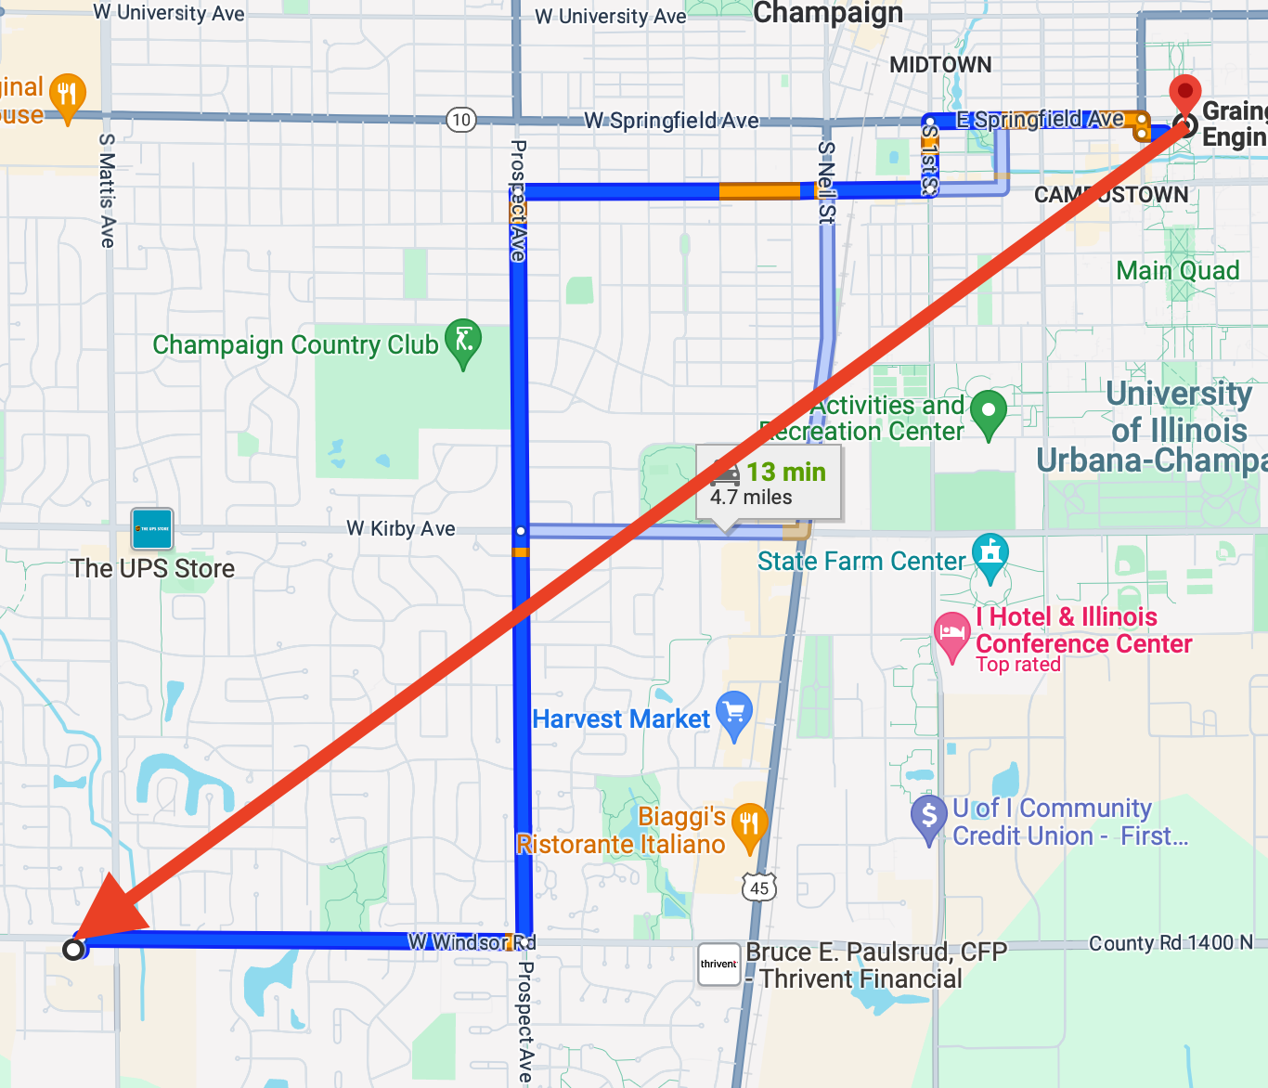
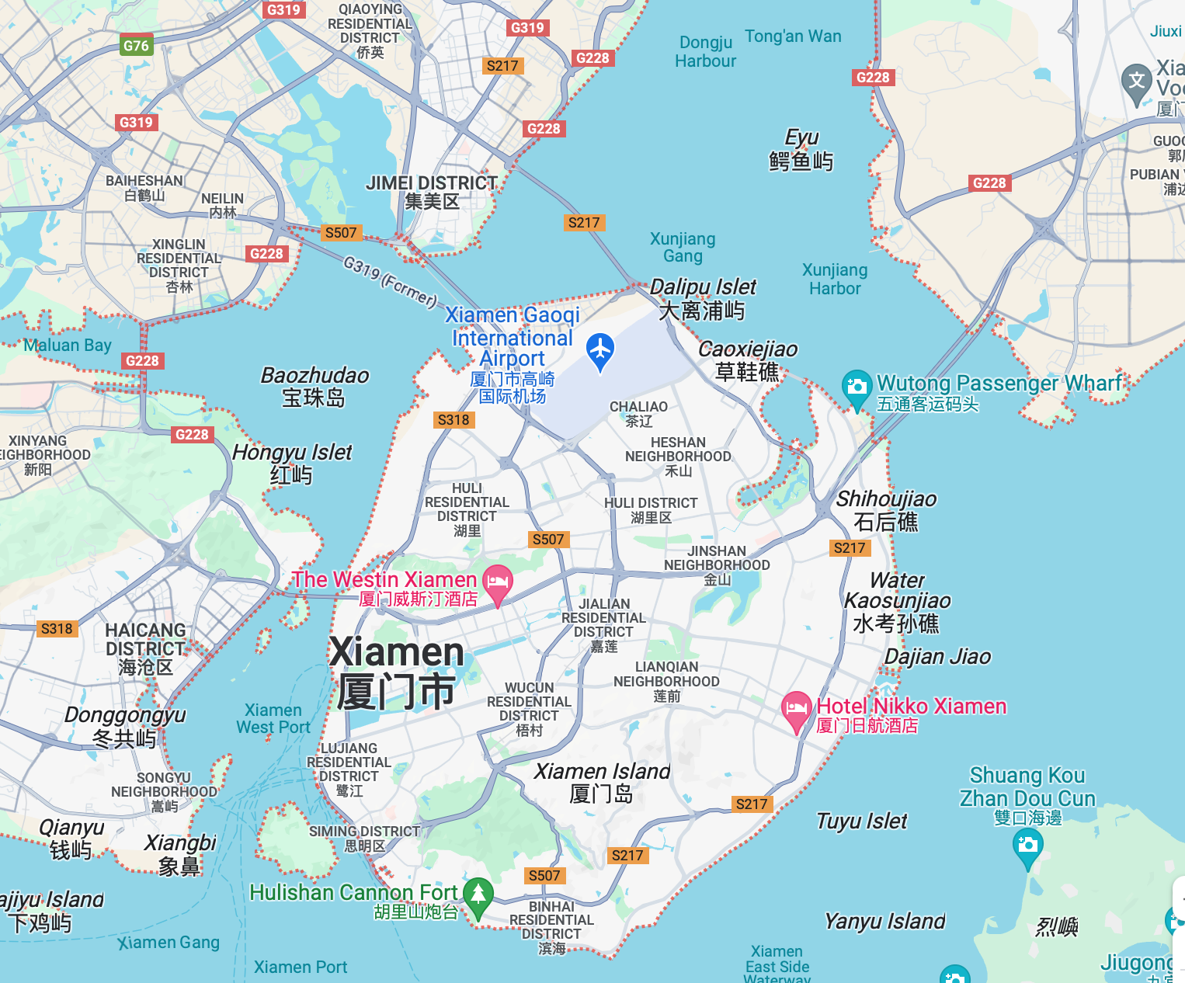
Drawbacks
Inaccurate length of distance
Inaccurate route planning
Straight-line Distance are usually shorter than Navigation distance
Xiamen has several cross-sea bridges

Slide 9
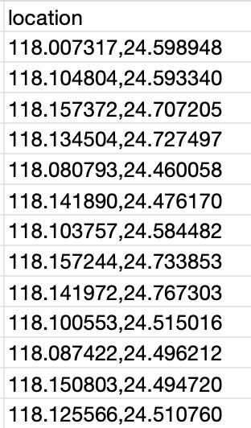

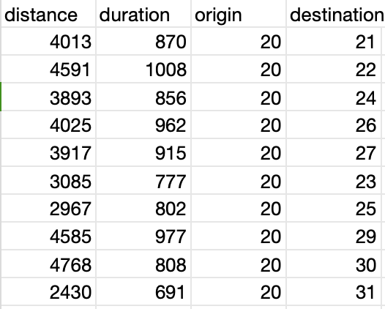
Navigation API
Using Gaode API to acquire longitude and latitude to simulate distance/duration matrix, our objective function is to minimize total distance
INPUT:
Location(Longitude, Lattitude)
OUTPUT:
Distance(m)/Duration(second) between arbitrary two locations

Slide 10
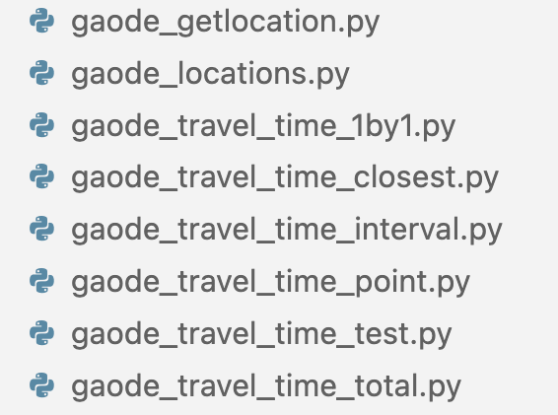
API Implementation
Address Name(Text) -> (Longitude, Latitude)
Departure (Longitude, Latitude), Destination(Longitude, Latitude) -> distance, duration between Departure and Destination
Limited daily quota (times)
Apply the stop and resume function for collecting data in progress
Set START_INDEX and END_INDEX, only acquire distance and duration data in these intervals
Limited API Keys
Detect usage condition for each API key (warning message when use out)

Slide 11
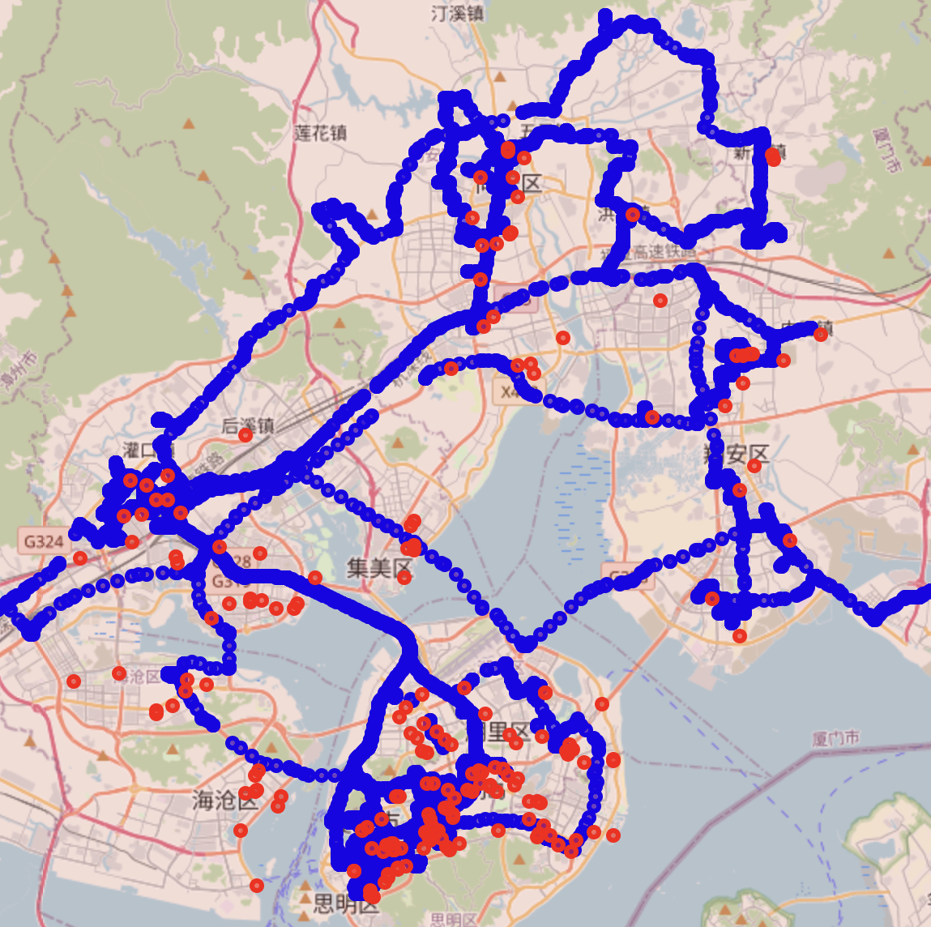
History vehicle driving record
'Driving_record.csv' files recorded each truck's location, mileage, and duration with 2 - 10 second interval time, real(accurate) data
Plot every truck's driving record and delivery locations on 07/21/2023
Prove the reliability of gaode_API's data

Slide 12
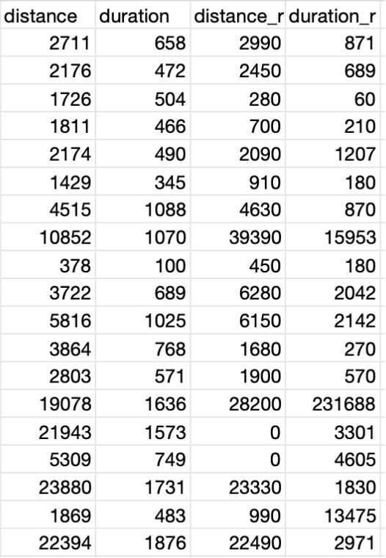
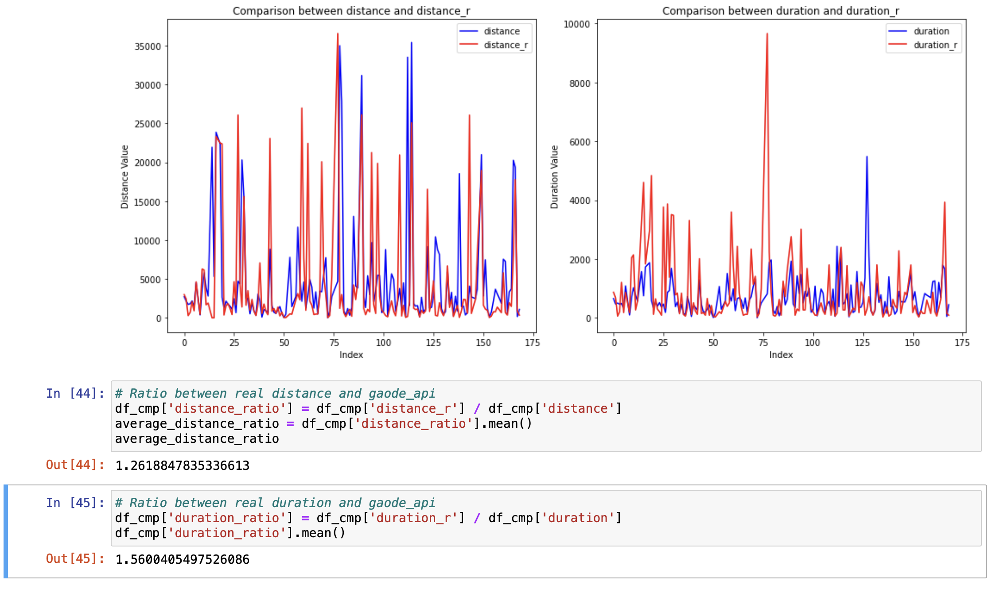
Real Data vs Gaode-API Data
Extracting distance/duration from driving record
Real data: distance_r/duration_r VS Gaode-API Data：distance/duration
distance_ratio: distance_r / distance ; duration_ratio: duration_r / duration
Gaode-API Data is reliable!

Slide 13
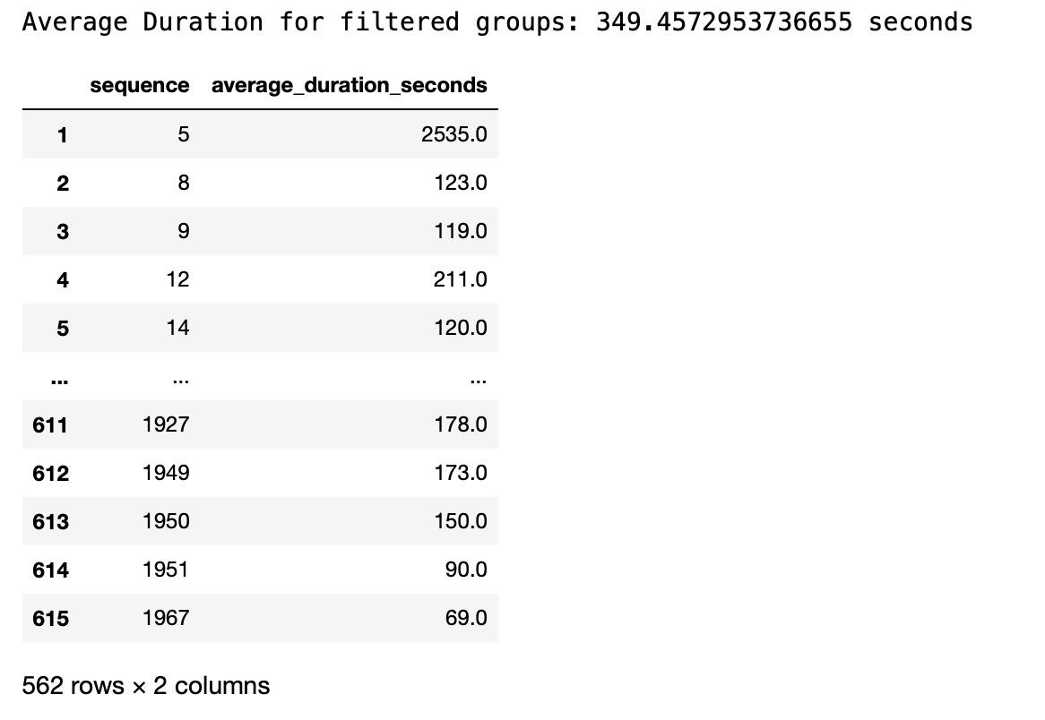
Standing Time
'Driving_record.csv' has column "Driving status" with value driving/stop, long time interval stop can be seen as standing time
Simulate the average standing time for each truck, with round 350 seconds
Estimate real standing time to 10 minutes, which will be used in optimization models

Slide 14
Delivery Routing Algorithm
Travelling Salesman Problem (TSP)
Vehicle Routing Problem (VRP)
Capacitated Vehicle Routing (CVRP)
Vehicle Routing with Time Windows (CVRPTW)
Prize-Collecting Vehicle Routing (PCVRP)

Slide 15
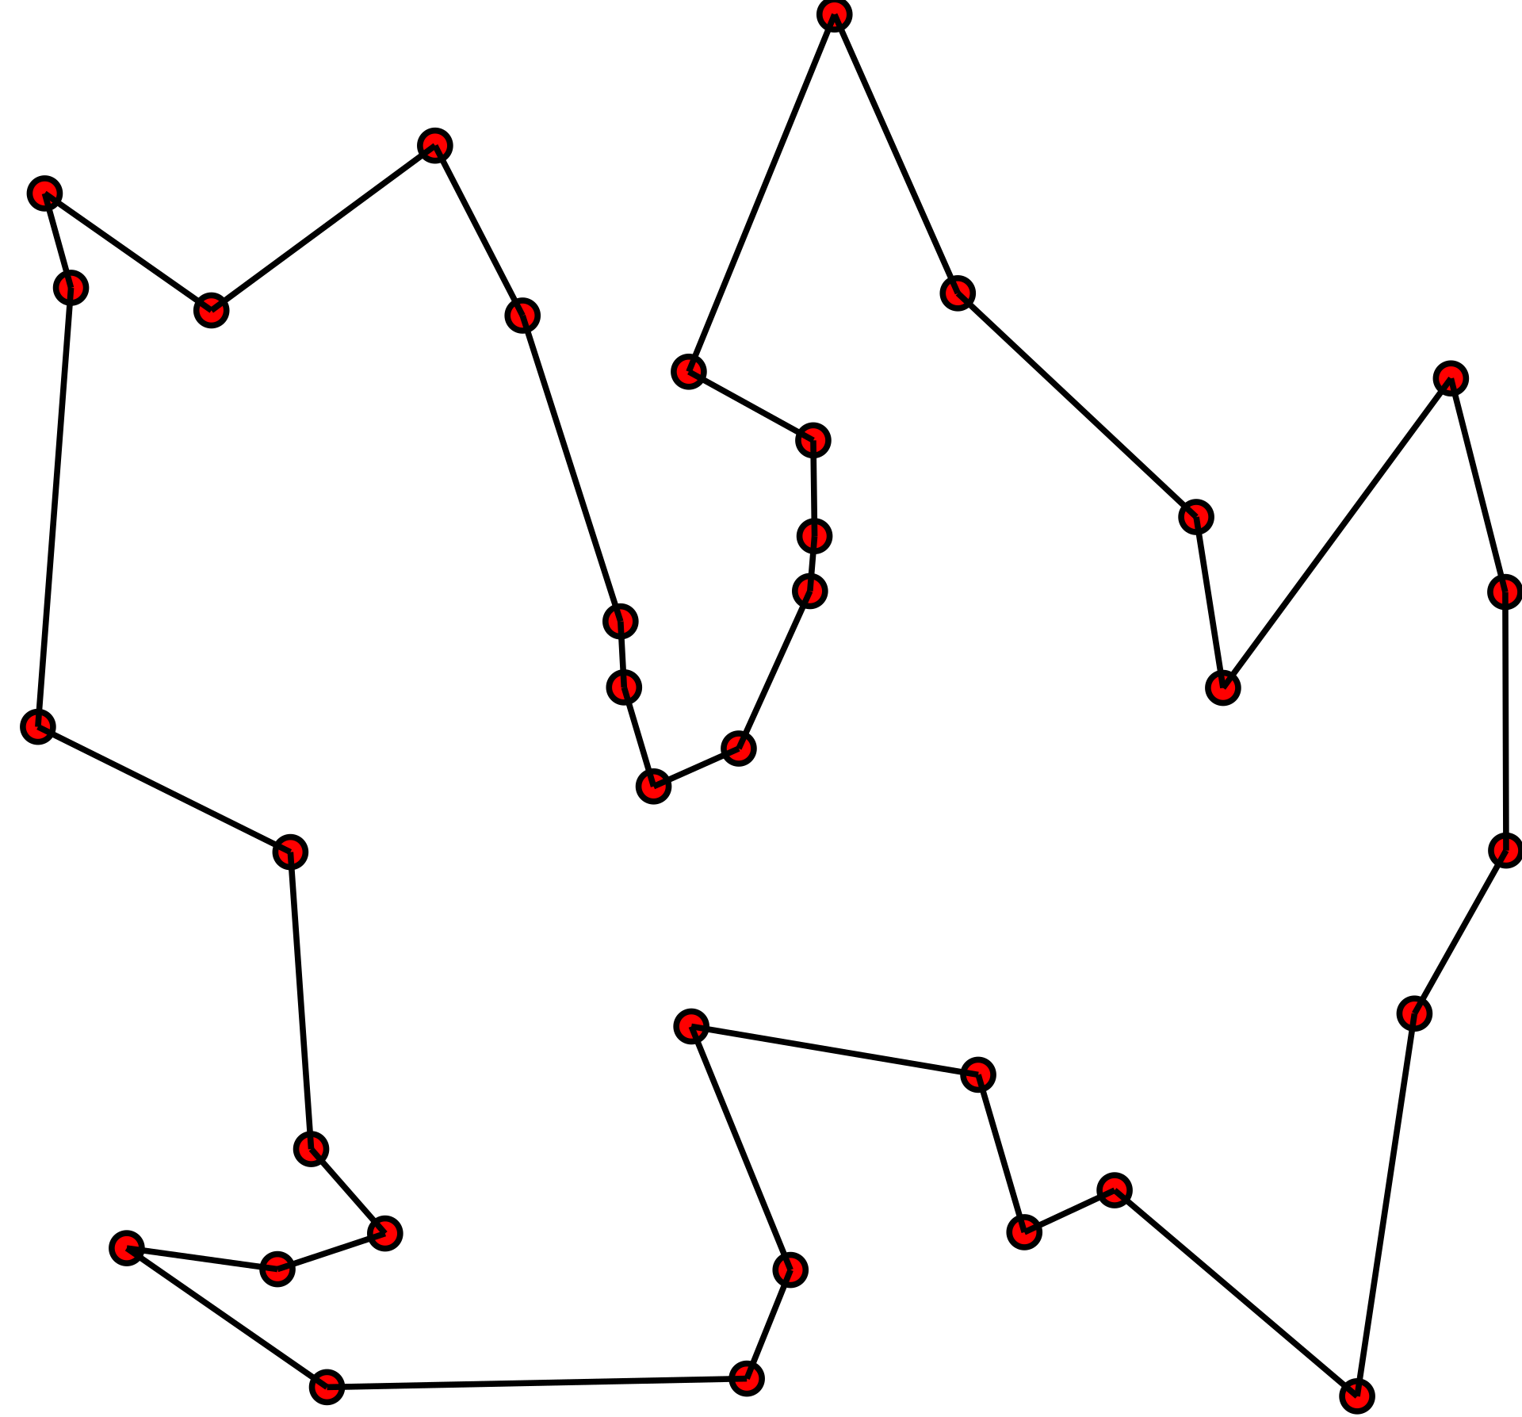
Travelling Salesman Problem
Given a list of cities and the distances between each pair of cities, what is the shortest possible route that visits each city exactly once and returns to the origin city?

Slide 16
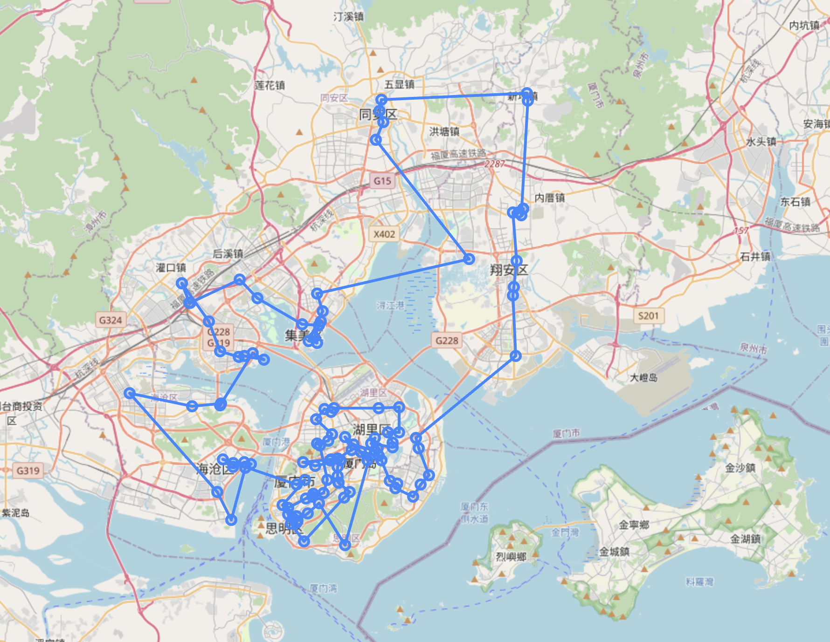
Travelling Salesman Problem
Solved by Or-Tools
Notes:
根据手头上现有的数据跑的TSP算法

Slide 17
Travelling Salesman Problem
In the TSP, you just want to find the optimal way — or the shortest possible route — to traverse a certain number of locations
Limits:
Assuming only one vehicle
Aims to find the shortest route, not considering other parameters such as cost, capacity, time interval.
Exponential possible routes generated
As the number of destinations rises, the number of possible routes surpasses the capabilities of even the fastest computers
For example, in a scenario with 10 destinations, there can be more than 300,000 possible routes. If the number of destinations increases to 15, the number of possible routes expands to more than 87 billion

Slide 18
Travelling Salesman Problem
Hence, we need more constraints
“Instead of considering one address or building at a time, one should consider all demand assigned to a route, the time spent delivering, and the geographical blocks assigned to a route,”
---- Andrea Qualizza, an Amazon senior principal scientist.

Slide 19
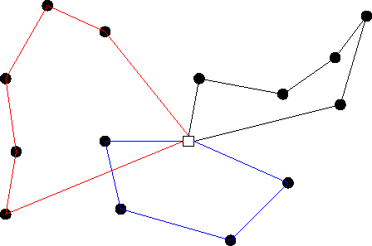
Vehicle Routing Problem
In the Vehicle Routing Problem (VRP), the goal is to find optimal routes for multiple vehicles visiting a set of locations.

Slide 20
Vehicle Routing Problem
Objective:
Minimize the global transportation cost based on the global distance travelled as well as the fixed costs associated with the used vehicles and drivers
Minimize the number of vehicles needed to serve all customers
Least variation in travel time and vehicle load
Minimize penalties for low quality service
Maximize a collected profit/score.
Variants:
Capacitated Vehicle Routing (CVRP)
Prize-Collecting Vehicle Routing (PCVRP)
Vehicle Routing with Time Windows (CVRPTW)
Notes:
根据不同的目的和效果，有不同的变种

Slide 21
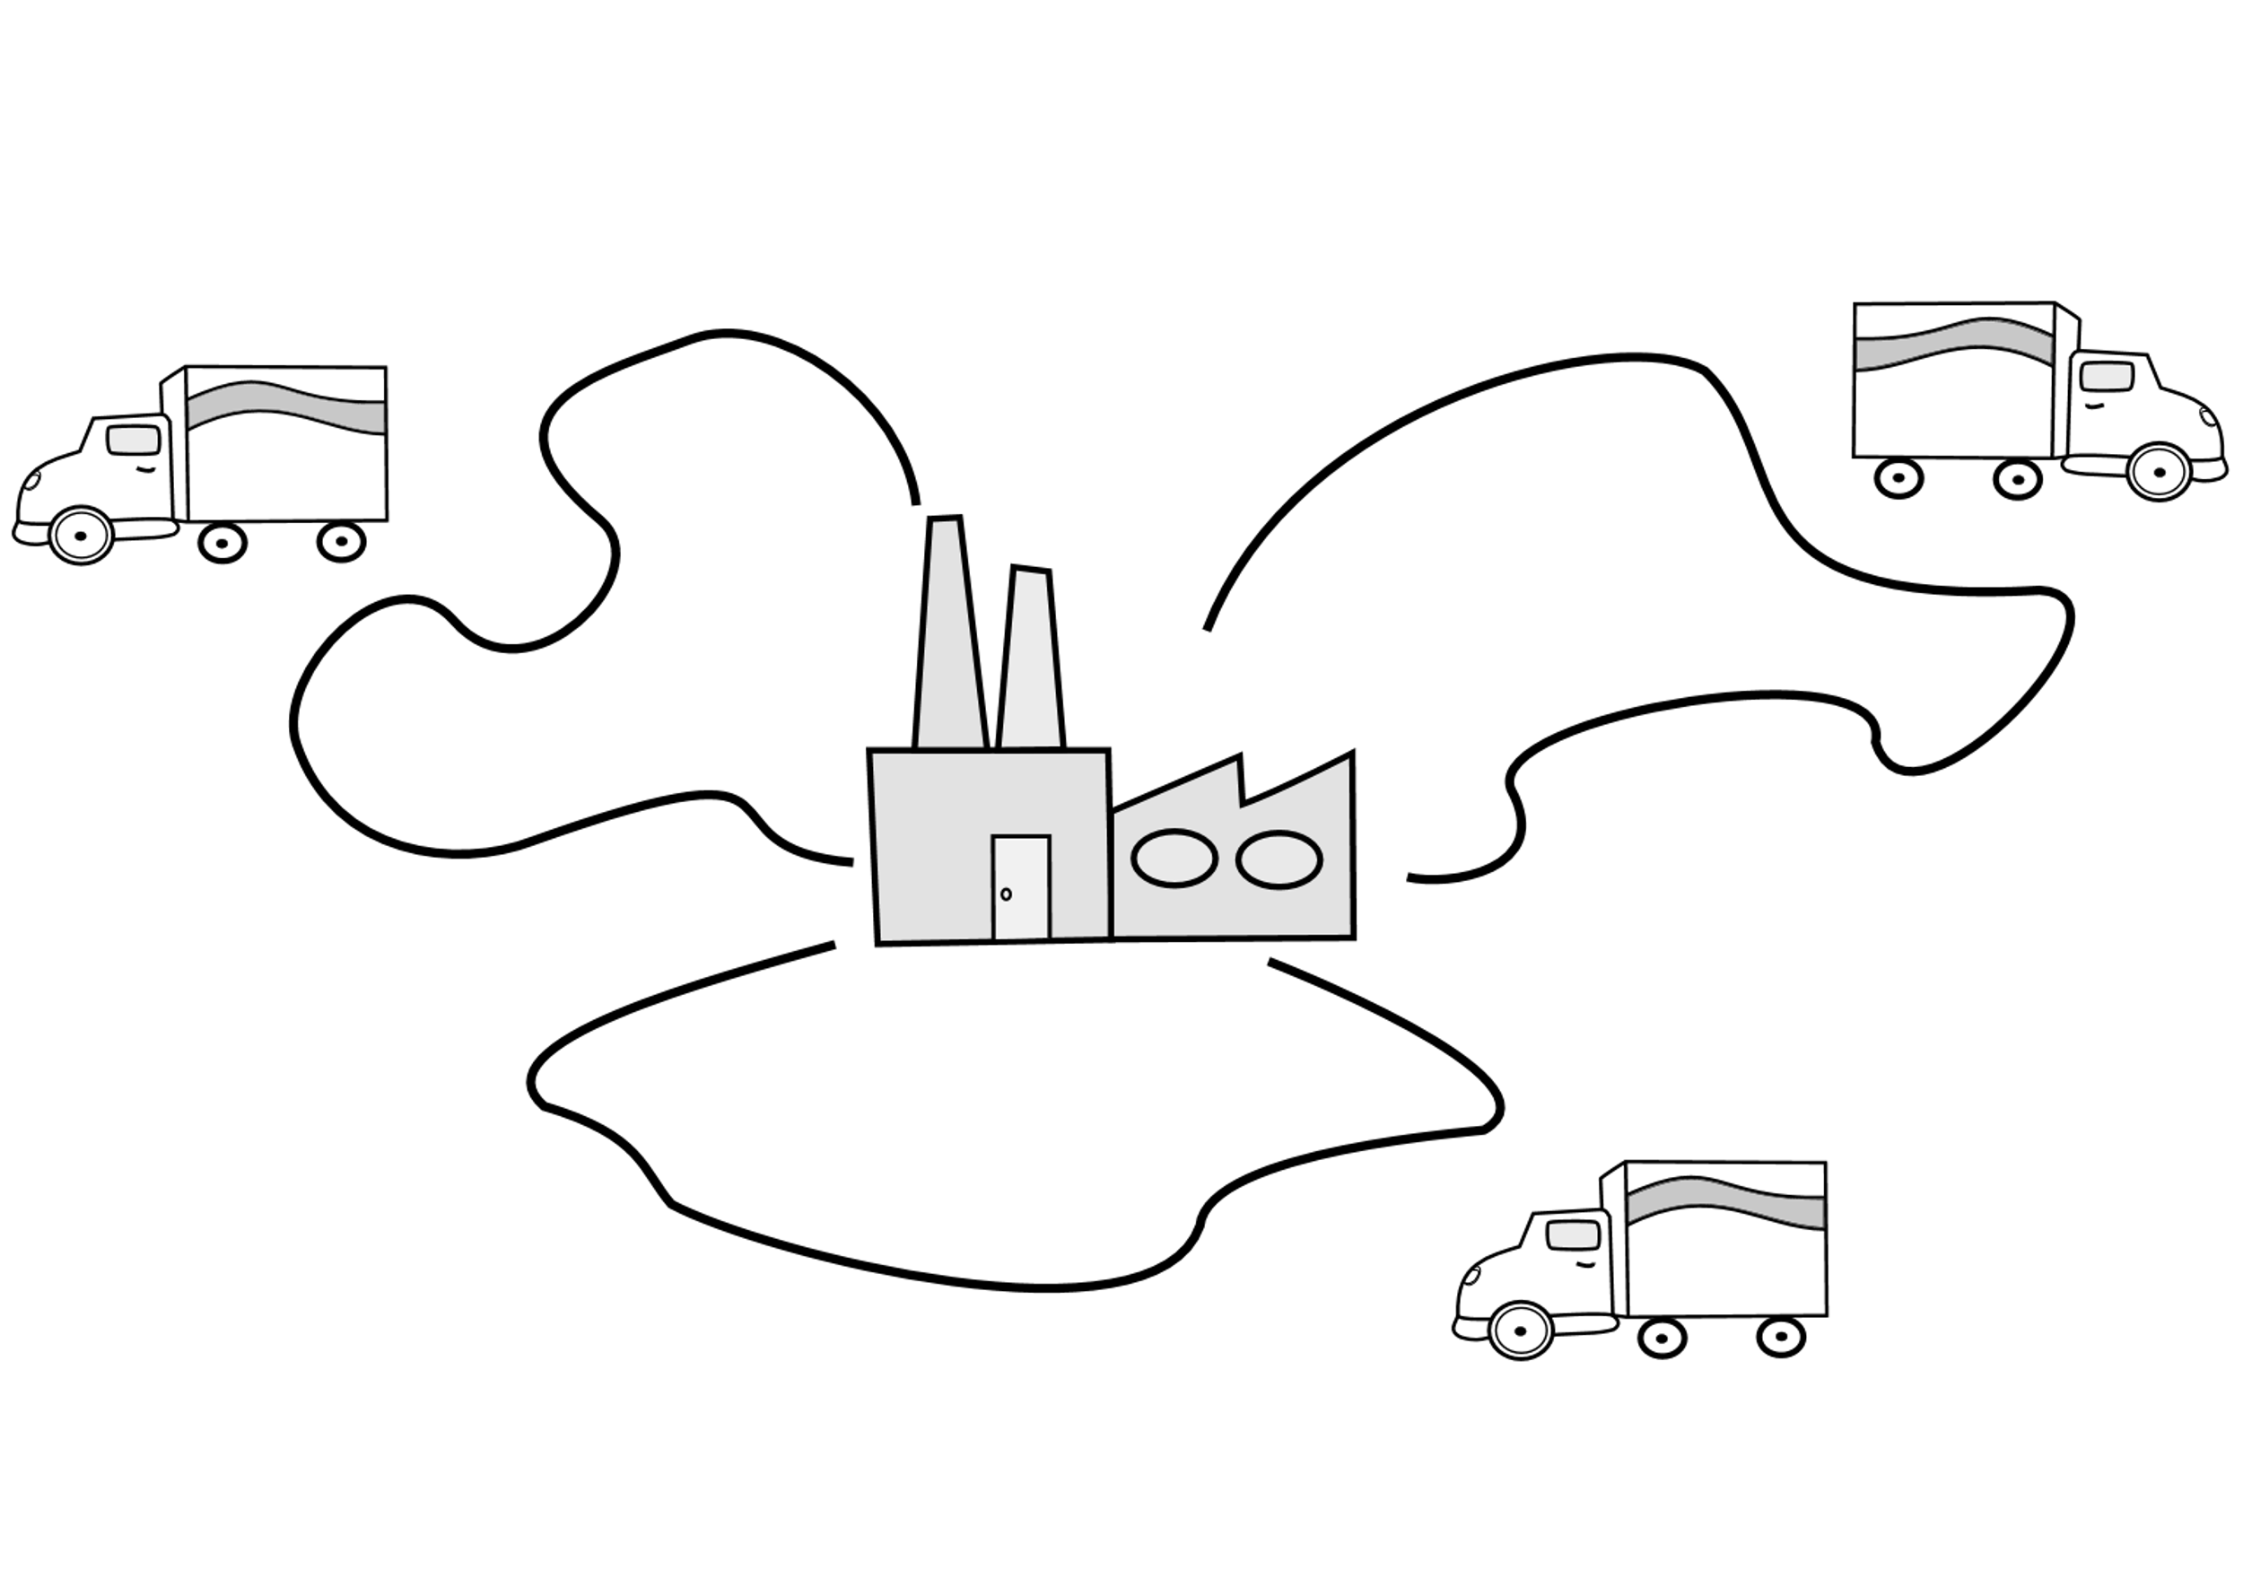
Capacitated Vehicle Routing Problem
In CVRP, a fleet of delivery vehicles with uniform capacity must service customers with known demand for a single commodity
Each customer can only be served by one vehicle
Objective:
Minimize the total travel distance
Minimize the fleet size
All customers are served and the total demand served by each truck does not exceed its capacity

Slide 22
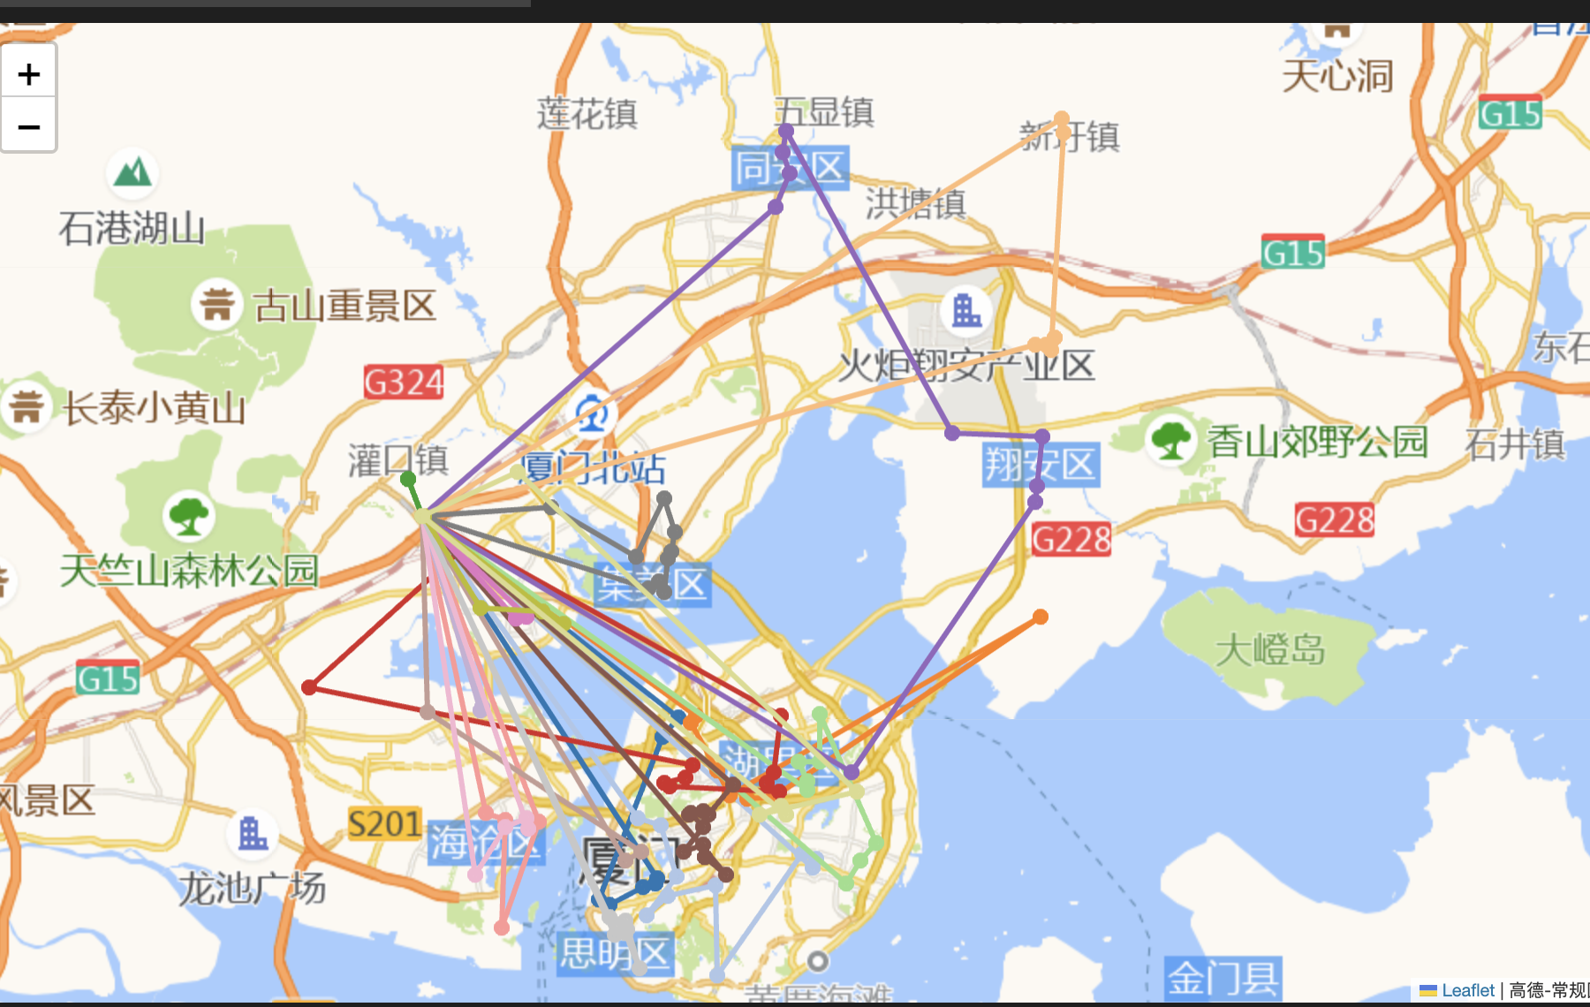
Capacitated Vehicle Routing Problem
Solved by Or-Tools

Slide 23
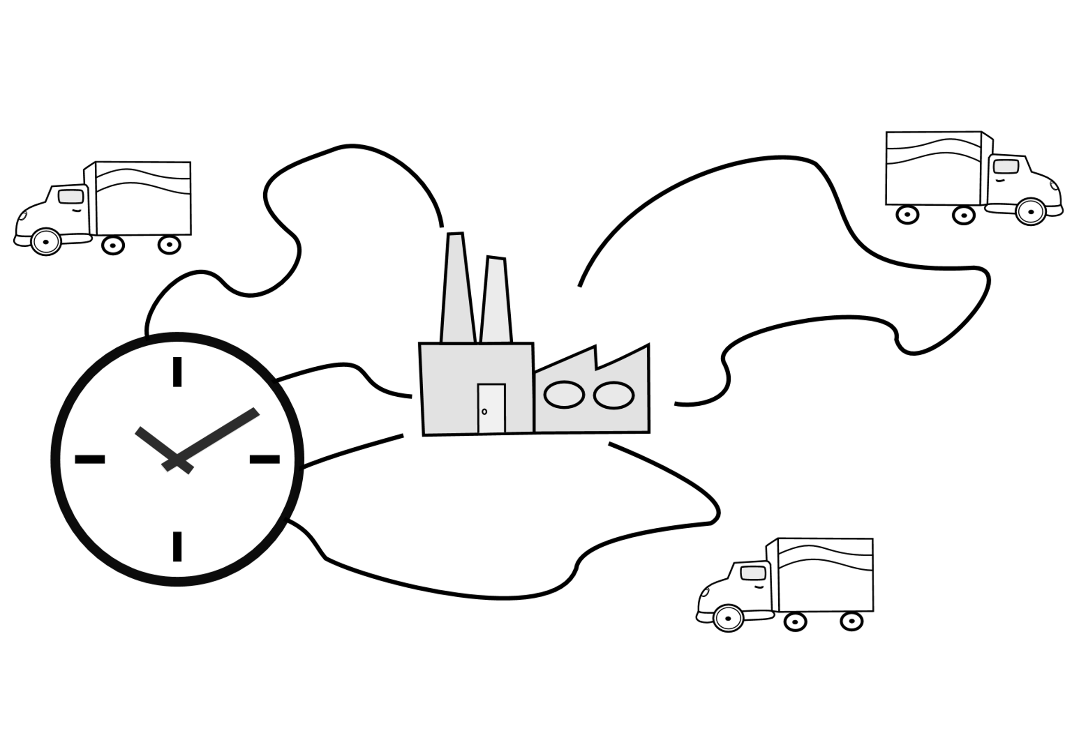
Vehicle Routing with Time Windows
In CVRPTW, a fleet of delivery vehicles with uniform capacity must service customers with known demand and opening hours for a single commodity
Each customer can only be served by one vehicle
Objective:
Minimize the total travel distance
Minimize the fleet size
All customers are served and the total demand served by each truck does not exceed its capacity
Ensure arrival time is within opening hours and minimize waiting time
Notes:
用于送医院门店单

Slide 24
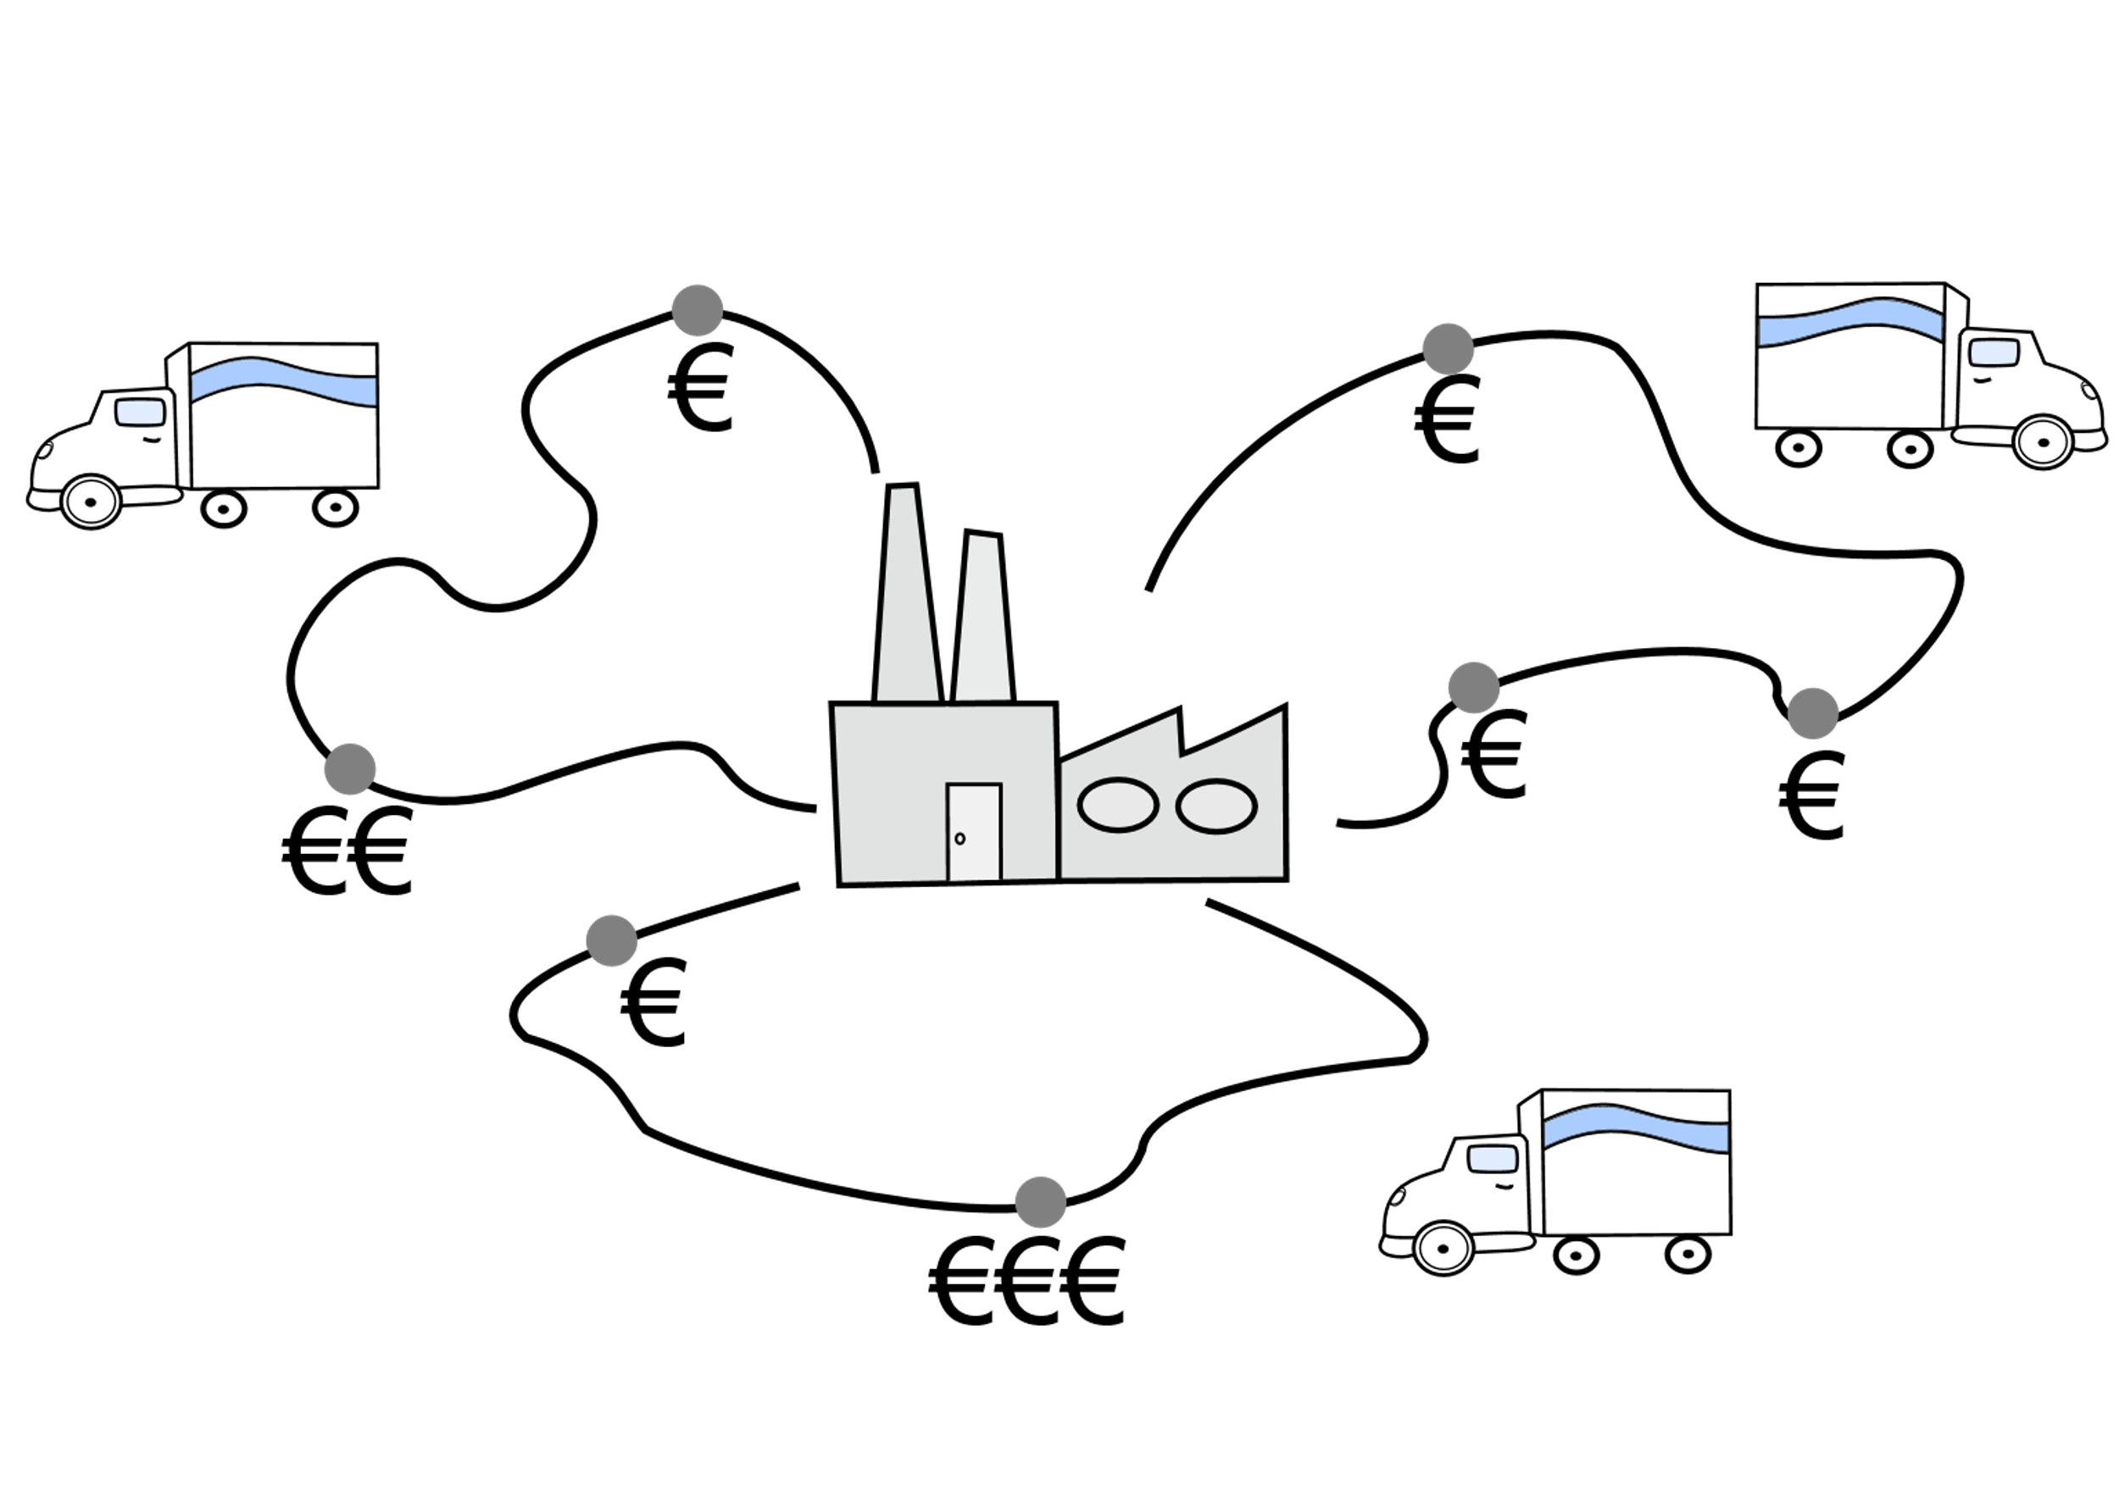
Prize-Collecting Vehicle Routing Problem
In PCVRP, a fleet of vehicles with uniform capacity can deliver customers with known demand and prize for a single commodity
Each customer might be served by at most one vehicle
Objective:
Minimize the total travel distance
Minimize the fleet size
Maximize the total prize collected
A predefined amount of demands are satisfied and the total demand served by each truck does not exceed its capacity
Notes:
可以用于冷链，急送，weight当作prize；跑完一趟不一定走过所有customers，优先走prize最高的customer

Slide 25

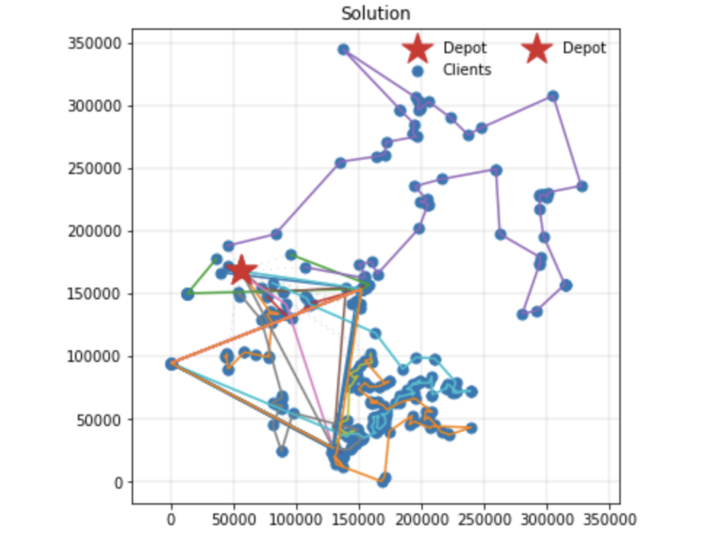
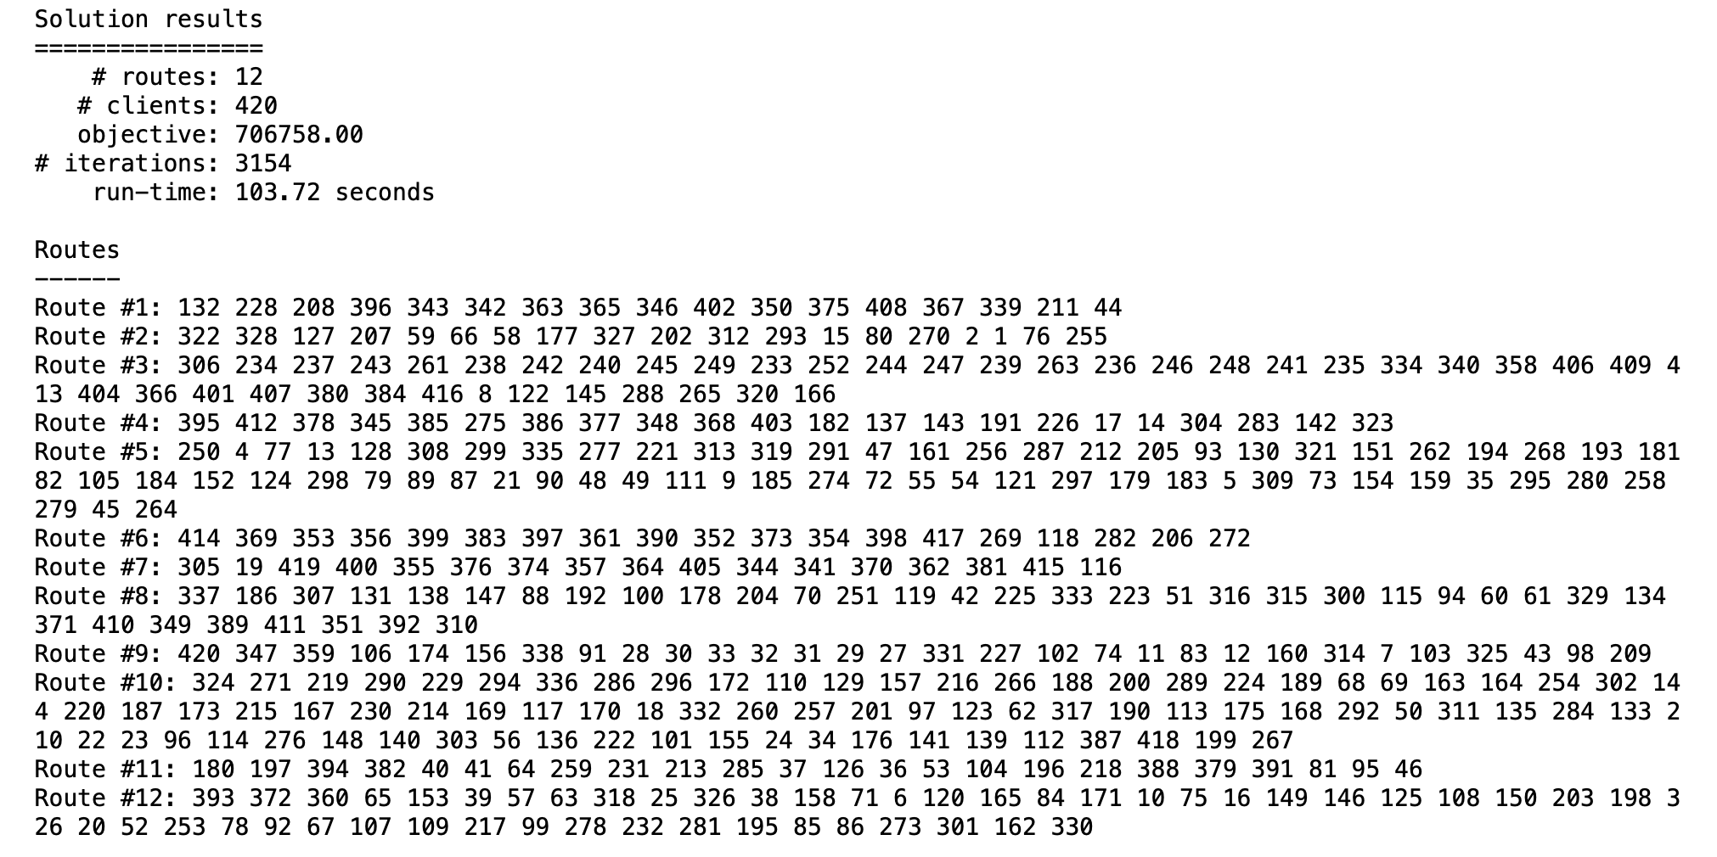

Models Simulation (PyVrp)
Hybrid genetic search (HGS) algorithm
Input: dis_mat, dur_mat, demand, vehicle capacity

Slide 26

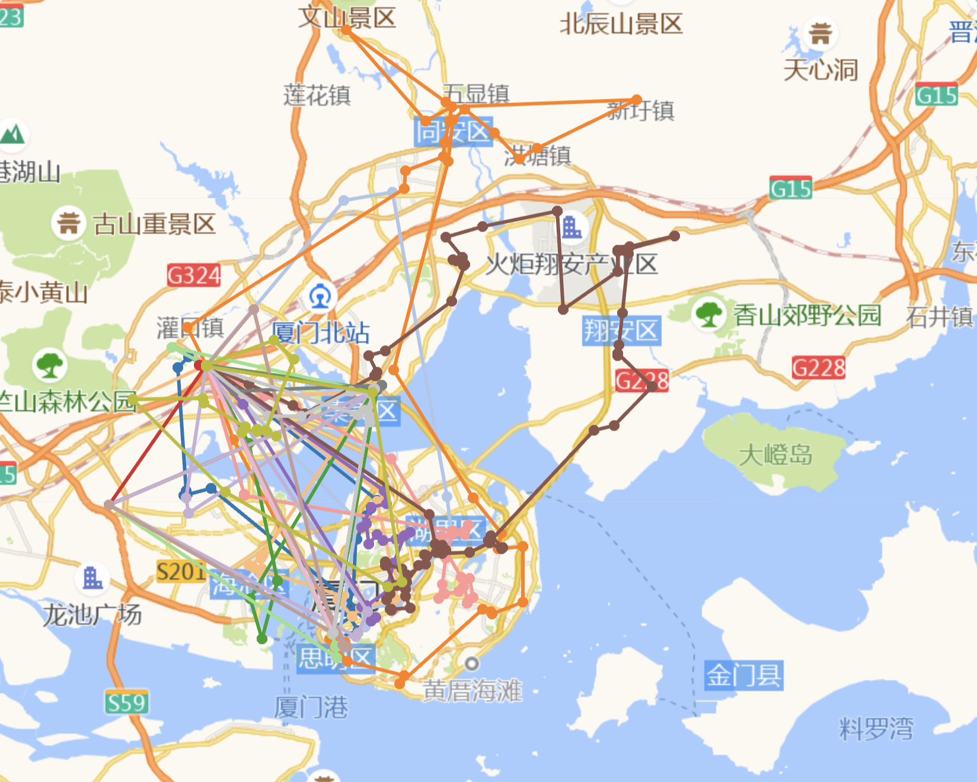
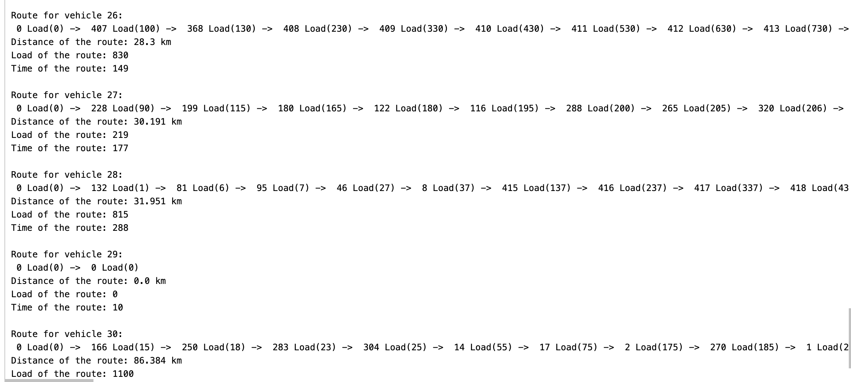
Models Simulation (Or-tools)
Constraint programming and customizable search algorithms
Input: dis_mat, dur_mat, demand, vehicle capacity
Routes' number: 17, Vehicles' number: 30
Total distance: 1138.509 km; Total time: 118.05 h; Total demand: 18328
Average distance: 66.97 km; Average time: 6.944h; Avg demand: 1078.12

Slide 27
Conclusion
PyVRP achieved a significantly lower total distance (706.758 km) compared to OR-Tools, suggesting it might have found a more efficient set of routes in terms of distance. However, it did so with fewer routes (12) and higher average demand per route.
OR-Tools, on the other hand, resulted in a higher total distance (1138.509 km) but used more routes (17), vehicles (30), and less demand for each route. This could indicate an approach to balance route distances and the number of routes or vehicles used.
We still need to consider other factors and requirements from Luyan, like time, number of vehicles, vehicles' capacity, and demand per route.

Slide 28
Future works
Multiple commodities
Daily Optimization
Optimize on vehicle loading
Special Shipping conditions:
Cold-Chain
Urgent order

Slide 29
Reference
PyVRP: https://pyvrp.org/
OR-Tools: https://developers.google.com/optimization/introduction
https://proceedings.neurips.cc/paper_files/paper/2018/file/9fb4651c05b2ed70fba5afe0b039a550-Paper.pdf
https://euro-neurips-vrp-2022.challenges.ortec.com/
https://www.researchgate.net/publication/330668917_Solving_a_dynamic_vehicle_routing_problem_with_soft_time_windows_based_on_static_problem_resolution_by_a_hybrid_approach
Amazon Fulfillment Network: https://pubsonline.informs.org/do/10.1287/orms.2022.05.24n/full/

Slide 30

Thank you

